Slide 1
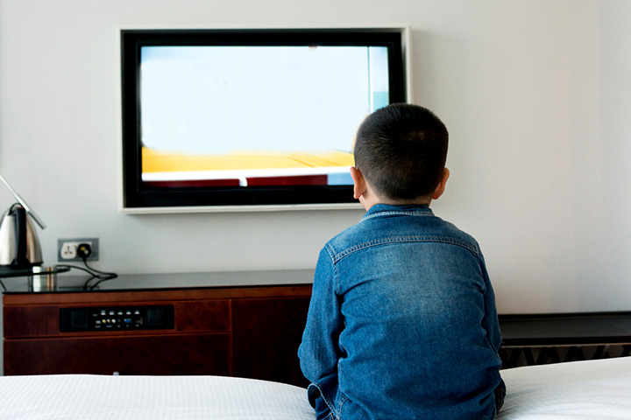
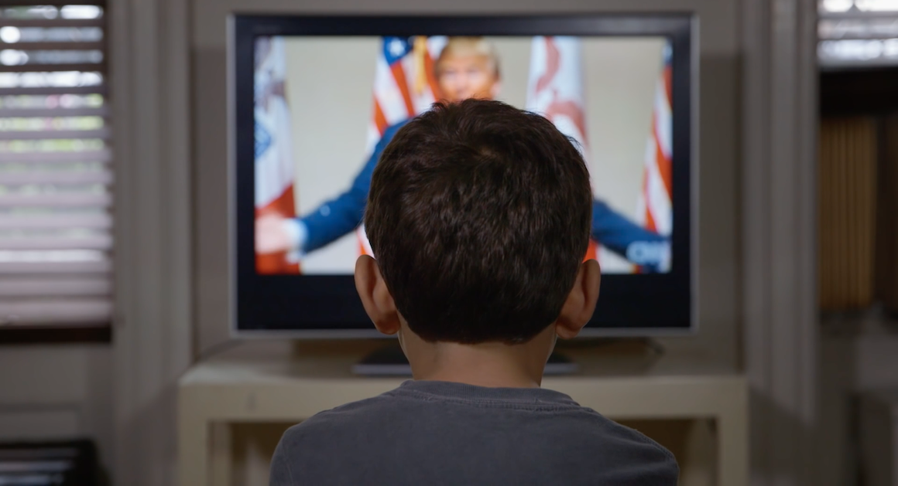
Video Essay Evaluation

Slide 2
Context
While watching tv can help a child with many things such as their speech development and teaching them life lessons for example learning how to share etc. However some of the programs that children are watching or only watching because their parents are watching them have proved to be not appropriate.
These shows are allowing children to mirror the actions that they are seeing with siblings and in school.

Slide 3
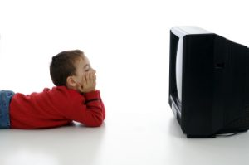
Research
Survey
Short clips from the shows
Expert articles
Mums net

Slide 4
Planning
Research
Interviews with teachers, parents and teenager
Clips from shows

Slide 5
Problem solving
Timings
Finding appropriate clips
Interviewing the different people and making sure they have the right idea.

Slide 6
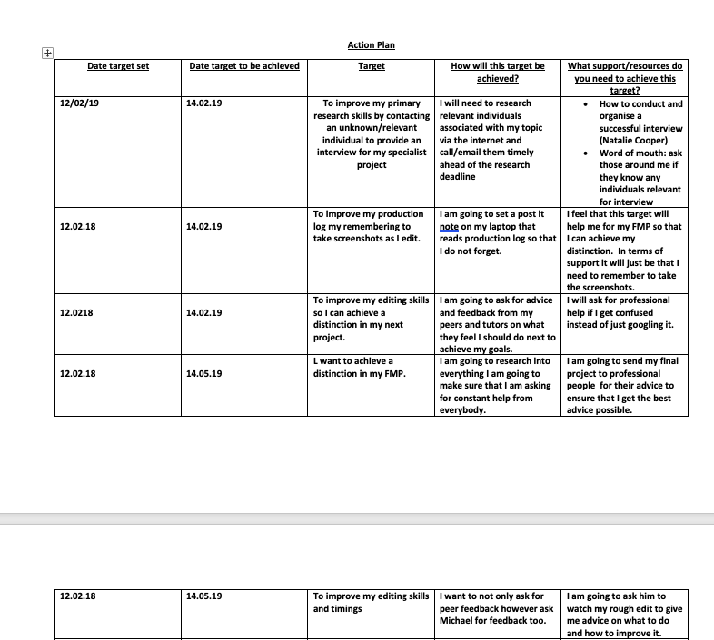
Action Plan

