Slide 1
Romantic Comedy
Interactive Short Film
Chloe, Elise & Chris

Slide 2
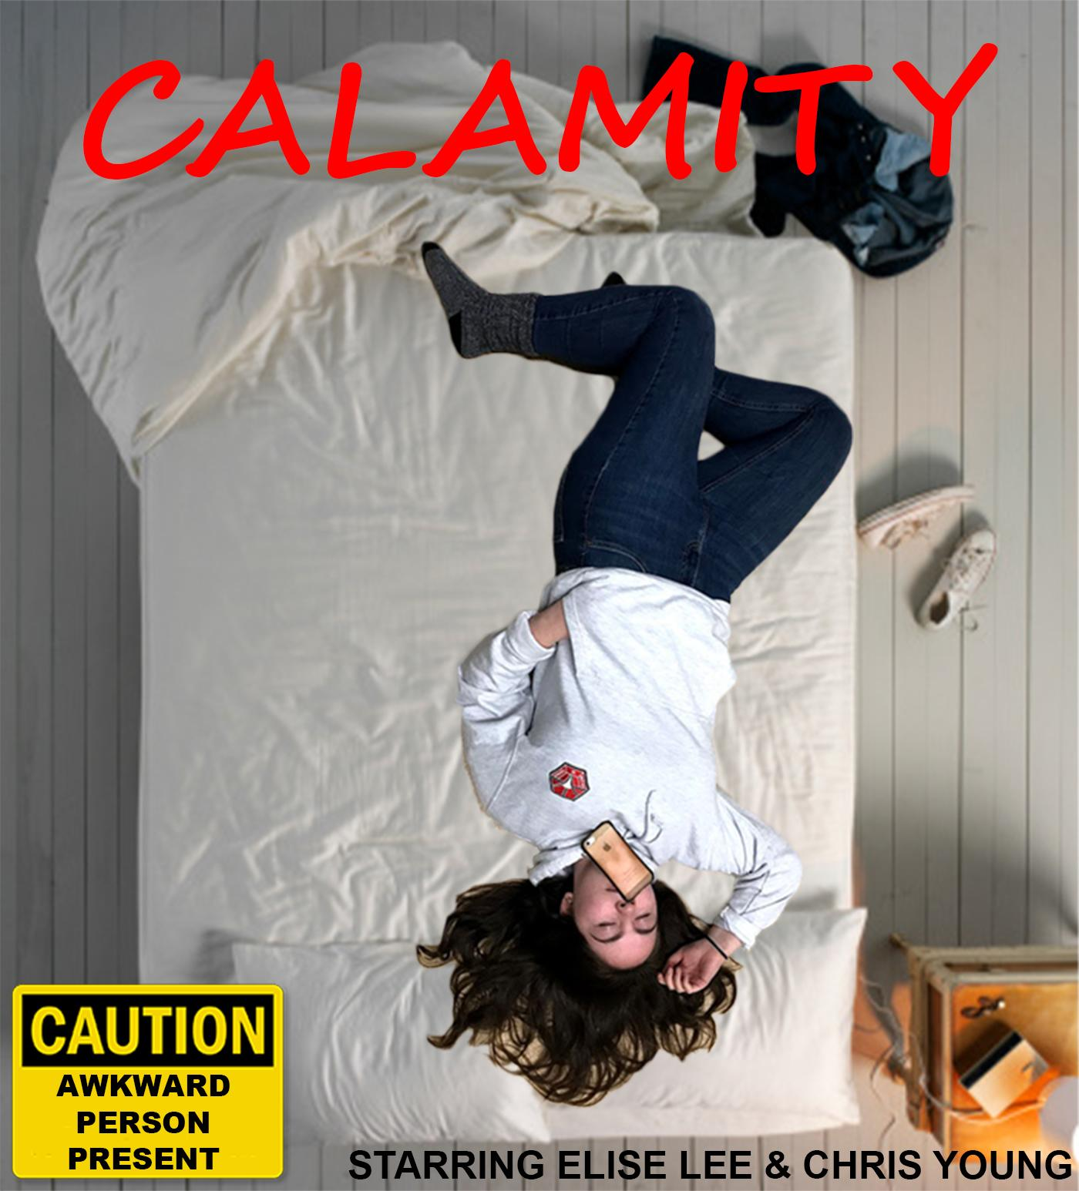

Slide 3
Synopsis
Welcome to the life of Calamity, an 18 year old girl who manages to end up in the most cringe worthy unimaginable awkward situations. When Calamity is to step out of her comfort zone by going on a blind date, her life greets her with another awkward situation.
Notes:
Chris
Welcome to the life of Calamity, an 18 year old girl who manages to end up in the most cringe worthy unimaginable awkward situations. When Calamity is to step out of her comfort zone by going on a blind date, her life greets her with another awkward situation.

Slide 4
Interactive Flow Chart
Call about blind date, then gets ready for the date
Fake a call
Cook Breakfast
Sprint to work
Trip in front of date
Sandwich
At lunch time goes and gets lunch
Pretend you have to leave and trip over everything
Hit Snooze
Salad
Crash in to date with trolley
Cereal
Rush to work
Alarm goes off
Get up
No breakfast?
Early for work
Trip in front of date
Fake a call
Sandwich
Decide to get lunch
Breakfast
Early for work
Salad
Crash in to date with trolley
Continue to be awkward
Notes:
Chris

Slide 5
Genre Conventions
The conventions of our genre our quite well known,for example the couple always end up together, there is always a fight at some point, and one of the characters will always have some kind of sub story.
While we will focus on these conventions we also want to explore and switch up some of this by instead of the leading female being girly we wanted to make her nerdy. And instead of making the male awkward we wanted to make him the successful one that is just looking for someone to love.
Notes:
Chloe

Slide 6


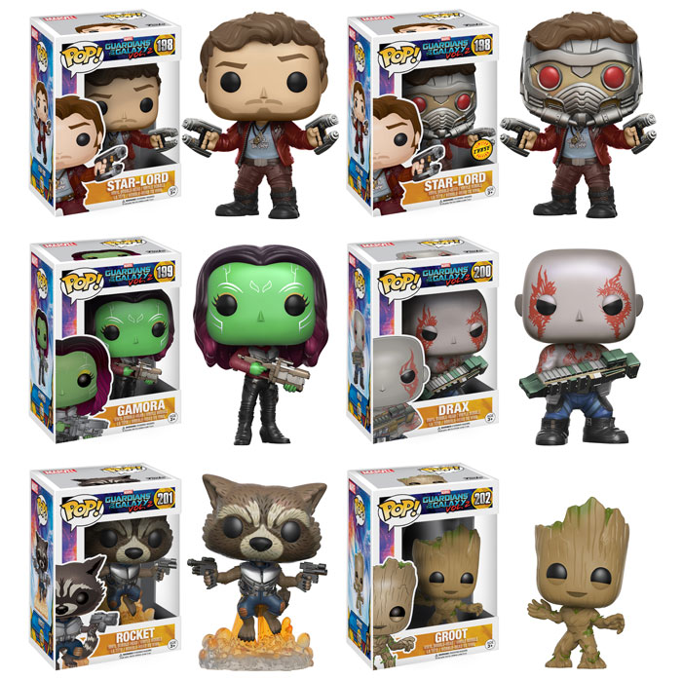
Visual Storytelling
Iconography
Always late
Phone
Carefully planned shots
Everything has a purpose
Notes:
chris

Slide 7
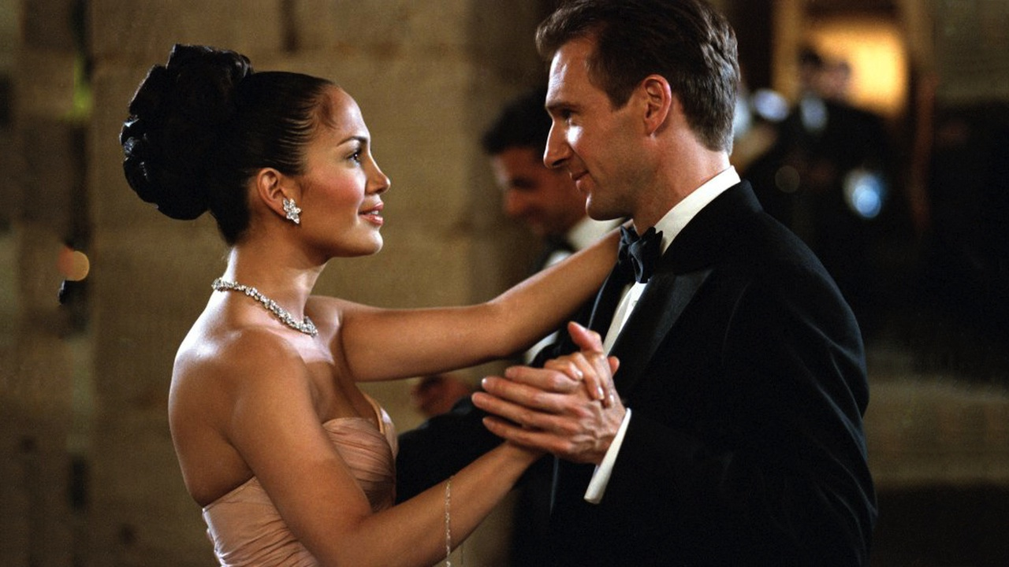
Informing Our Idea
Needs to be a happy ending
Characters need to have an interesting life
Slapstick comedy
Notes:
Elise

Slide 8


Inspirations
Our inspirations were Man up and Bridget Jones’s Diary, we chose these two films because both leading female roles are awkward and clumsy just like our character.
Notes:
Elise

Slide 9


Target Audience
Usually ranges 13-55
For ours 12-25
More so girls
Notes:
Chloe

Slide 10
Moodboard
Notes:
Chris

Slide 11
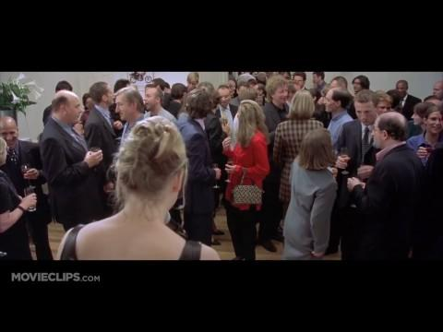
Notes:
Chris

Slide 12
Resources
Props -
Photo frames, Funko pops, phone and a mouse mat
Costume -
Calamity - Work - Muted clothing, jeans and converse
Date - Dressy top, jeans and converse
- Pajamas
Mark - Work - Shirt, jeans, vans
Date - Shirt, jeans, suede boots
Waitress - Shirt, apron, jeans and converse
Boss - Shirt, jeans, converse
Notes:
Chloe props show personality and what calamity likes
Muted for work, yet still casual, compo of smart and casual, a little more personality is shown in her date outfit. Still sticks to jean and converse, muted colors, not as confident keep them hidden
Mark v plain
Waitress - converse wont be in shot
Boss - casual environment

Slide 13
Resources Pt 2
Crew - Camera, softbox lights, zoom
Locations - Chris’s house
- Shop (Co-op)
- Pub (Jolly Toppers)
- College (Office)
Notes:
Chloe

Slide 14
Schedule
Monday | Tuesday | Wednesday
Pub scene (scene) | House scenes (Chris’ house) | Office scene
 | Village scenes (co-op) or (Tesco) | Calamity rushing around (cutaways)
Notes:
Elise

Slide 15
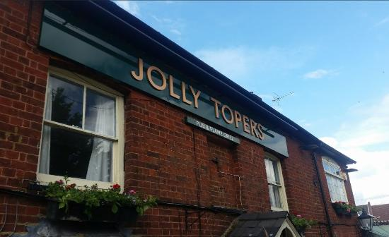
Contingency Plan
We have asked a local pub called Jolly Topers if we can film our date scene in their restaurant area. If they decided to say no or we do not hear back from them in plenty of time then our contingency plan is to film the date scene at Chris’s house.
Notes:
Elise

Slide 16
Roles
Elise: Producer
Chris: Director
Chloe: Camera Operator
*other jobs such as sound and lighting will be spread across group members
Notes:
Chloe

Slide 17
Any
Questions?

